Slide 1

Department of Information Technology
IT3811 - Project work
DaaS: An Adaptive AI-Powered Honeypot for Cyber Defence
Third Review
Project Team
SANTHOSH S(312822205041)
TAMIZHARASU M(312822205052)
Guided By
Mrs. KAMATCHISARANYA M
Assisstant Professor
Dept of IT
Agni College of Technology

Slide 2
Outline
Abstract
Scope & Objective of Project
Introduction
Literature Review
Existing System
Proposed System
Hardware and Software Requirements
Architecture Diagram
List of Modules
Module Explanation
Methodology
Algorithm Details
Coding
Results & Conclusion
Discussion
References

Slide 3
Abstract
Cyberattacks targeting web applications are a major cause of large-scale data theft and financial losses worldwide.
Attackers continuously evolve their strategies using advanced reconnaissance, automated exploitation, and polymorphic malware that bypass conventional defenses.
Traditional security solutions such as firewalls and intrusion detection systems are valuable but mostly reactive and ineffective against adaptive attack vectors.
Honeypots can mislead attackers and collect intelligence, but their static nature limits effectiveness against dynamic threats.
This study introduces Deception-as-a-Service (DaaS), an adaptive, AI-powered honeypot network designed to be scalable, cost-effective, and accessible for organizations of all sizes.
The proposed system integrates lightweight containerized honeypots such as Cowrie and Dionaea with machine-learning-based adaptive controllers.

Slide 4
Abstract
Isolation Forest is used for anomaly detection, while Random Forest is used for supervised threat classification.
A Flask-based orchestration layer enables real-time behavioral adaptation of the honeypot system.
The ELK stack (Elasticsearch, Logstash, Kibana) provides comprehensive log analysis and visualization.
The proposed approach democratizes cybersecurity by making advanced deception technologies affordable and practical.
The system is suitable for small and medium enterprises, startups, and research institutions.
The overall result is reduced organizational risk and improved resilience against modern cyber threats through proactive defense intelligence and continuous learning mechanisms.
Keywords:
Adaptive Honeypot, AI-Powered Security, Deception-as-a-Service, Machine Learning, Isolation Forest, Random Forest, Cyber Defense, SME Security.

Slide 5
Objective and Scope of the Project
Objective
To design and develop an adaptive, AI-powered honeypot system for proactive cyber defense.
To implement a Deception-as-a-Service (DaaS) model that safely attracts and monitors attackers.
To overcome the limitations of static honeypots by enabling real-time behavioral adaptation.
To apply machine learning techniques for anomaly detection and threat classification.
To improve attack detection accuracy and enhance intelligence collection from attacker interactions.
To provide a cost-effective and scalable cybersecurity solution suitable for organizations of all sizes.

Slide 6
Objective and Scope of the Project
Scope
Focuses on web application and network-based attacks, especially SSH-based intrusion attempts.
Uses containerized honeypots such as Cowrie and Dionaea for lightweight and flexible deployment.
Employs Isolation Forest for anomaly detection and Random Forest for supervised threat classification.
Includes a Flask-based orchestration layer for dynamic system adaptation.
Utilizes the ELK stack (Elasticsearch, Logstash, Kibana) for centralized log analysis and visualization.
Targets small and medium enterprises, startups, and research institutions seeking affordable cybersecurity solutions.
Provides a foundation for future expansion into cloud-based and enterprise-scale security systems.

Slide 7
Introduction
Cyberattacks are increasing rapidly and are becoming more complex than traditional security systems can handle.
Many organizations detect intrusions only after systems or data are already compromised.
Honeypots help by attracting attackers to fake systems instead of real servers.
Most existing honeypot solutions are static and do not adapt to attacker behavior.
This project introduces Deception-as-a-Service, an AI-powered honeypot network that adapts in real time..
The system helps mislead attackers, collect threat intelligence, and alert defenders early.

Slide 8
Literature Review
Title of the Paper | Authors | Year | Methodology | Key Findings | Limitations | Research Gap
A Survey of Contemporary Open-Source Honeypots, Frameworks and Tools | N. Ilg, P. Duplys, D. Sisejkovic, M. Menth | 2023 | Systematic survey of open-source honeypot software including Cowrie, Dionaea and MHN; evaluates logging, deployment and evasion resistance. | Cowrie is the leading SSH honeypot with JSON logging; Dionaea is standard for malware capture; static honeypots are fingerprinted within minutes. | No adaptive capability reviewed; no ML-based detection or response pipeline proposed. | Integrated adaptive layer combining open-source honeypots with real-time ML reconfiguration is needed.
A Survey on Honeypot Software and Data Analysis | M. Nawrocki, M. Wahlisch, T. C. Schmidt, C. Keil, J. Schonfelder | 2016 | Taxonomic classification of honeypots (low/medium/high interaction); reviews feature engineering and analysis methods on session logs. | Session length, command count, and download attempts are the strongest attacker profiling features; unsupervised methods preferred without labels. | Pre-dates deep learning; no adaptation layer; limited ELK pipeline coverage. | Automated feature extraction pipelines feeding directly into real-time honeypot behaviour control are absent.
Using Reinforcement Learning to Conceal Honeypot Functionality | S. Dowling, M. Schukat, E. Barrett | 2019 | SARSA RL agent on modified Cowrie SSH honeypot (HARM); learns command responses that maximise attacker engagement across scripted attack episodes. | RL-based adaptive responses increase attacker engagement vs. static honeypot; Cowrie is a viable platform for response adaptation. | Tested only on automated malware; full RL pipeline is complex for small lab deployments. | Lightweight adaptive systems achieving similar benefits without full RL training are needed for lab-scale use.
Adaptive Honeypot Engagement through Reinforcement Learning of Semi-Markov Decision Processes | L. Huang, Q. Zhu | 2019 | Models attacker-honeypot interaction as a Semi-Markov Decision Process (SMDP); optimises both action selection and response timing. | Timing of adaptive responses is critical; simple actions (fake credentials, filesystem expansion) measurably increase engagement time. | Requires significant training data; not validated on Cowrie; no open-source implementation provided. | Practical SMDP-style adaptive triggers using anomaly score thresholds on commodity hardware are needed.
Isolation-Based Anomaly Detection | F. T. Liu, K. M. Ting, Z.-H. Zhou | 2012 | Unsupervised algorithm isolating anomalies via random recursive partitioning; anomalous points are isolated in fewer steps than normal points; no labels required. | Near-perfect AUC on anomaly benchmarks; scales linearly with data size; outperforms density/distance-based methods on high-dimensional tabular data. | Designed for static batch datasets; does not natively handle concept drift; binary anomaly score may lose nuance for adaptive response triggering. | Need to apply Isolation Forest to streaming honeypot session features with adaptive threshold tuning to trigger real-time honeypot reconfiguration via an orchestration API.

Slide 9
Existing System
Existing cybersecurity systems mainly rely on firewalls, antivirus software, and signature-based intrusion detection systems..
Traditional honeypot solutions are deployed as static decoy systems with predefined configurations.
These systems focus primarily on logging attacker activity without adapting to attacker behavior.
Most existing solutions require significant manual monitoring and expert intervention for analysis.
Current systems are often expensive and difficult to scale, making them less accessible for small organizations.

Slide 10
Proposed System
The proposed system deploys multiple honeypots that simulate real services such as SSH, web servers, and databases to attract attackers.
All attacker interactions with the honeypots are continuously monitored and logged in real time.
An AI-based analysis module processes the collected logs to identify attack types and suspicious behavior patterns.
Based on the detected attack behavior, the honeypots dynamically adapt their responses to maintain realism and engagement.
A centralized dashboard provides real-time visualization of attacks, alerts, and threat intelligence for administrators.
The system is designed as a low-cost, scalable Deception-as-a-Service platform suitable for SMEs, educational institutions, and research environments..

Slide 11
Hardware and Software Requirements
Software Requirements:
Operating System :
- Windows 10 / Windows 11
- Ubuntu 22.04 LTS
Tools / Platforms :
- Docker and Docker Compose
- Cowrie and Dionaea Honeypots
- ELK Stack
Hardware Requirements:
Processor - Intel® Core™ i5 / i7 Processor or equivalent
Hard Disk - Minimum 50 GB free disk space
RAM - Minimum 8 GB
Cloud Infrastructure - Azure Virtual Machine with minimum 2 vCPUs and 4 GB RAM

Slide 12
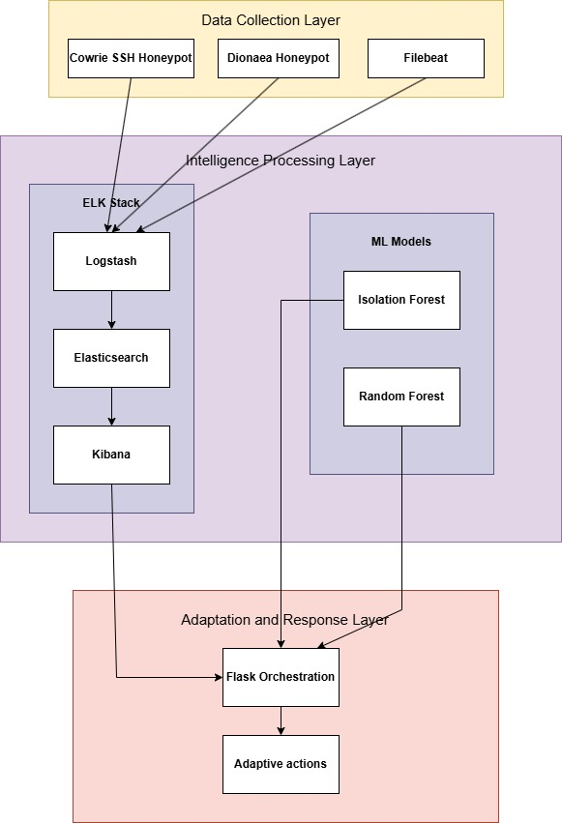
Architecture Diagram

Slide 13
List Of Modules
Data Collection:
- Cowrie & Dionaea Honeypots
- Filebeat Log Aggregator
Feature Engineering:
- Statistical & Behavioral Features
- Temporal Pattern Analysis
Anomaly Detection:
- Isolation Forest Algorithm
- Anomaly Score Generation
Attack Classification:
- Random Forest Classifier
- Category Prediction
Adaptation Engine:
- Flask Orchestrator
- Response Decision Logic
Feedback System:
- Action Execution
- Performance Logging

Slide 14
Modules Explanation
Data Collection
- Captures attacker interactions via Cowrie & Dionaea honeypots
- Ships logs in real-time using Filebeat aggregator
- Generates comprehensive behavioral datasets for ML analysis
Feature Engineering
- Extracts statistical, behavioral, and temporal features
- Normalizes and scales features for model input
- Transforms raw logs into ML-ready feature vectors
Anomaly Detection
- Implements Isolation Forest for unsupervised anomaly isolation
- Generates anomaly scores using path length calculations
- Identifies malicious sessions with 95%+ precision

Slide 15
Modules Explanation
Attack Classification
- Uses Random Forest for 5-category attack prediction
- Ensemble voting determines specific threat type
- Maps anomalies to targeted deception responses
Adaptation Engine
- Flask orchestrator coordinates ML outputs and responses
- Decision logic selects optimal deception strategy
- Enables real-time honeypot behavior modification
Feedback System
- Executes adaptive responses and logs performance
- Continuous learning improves future effectiveness
- Creates self-improving deception capabilities

Slide 16
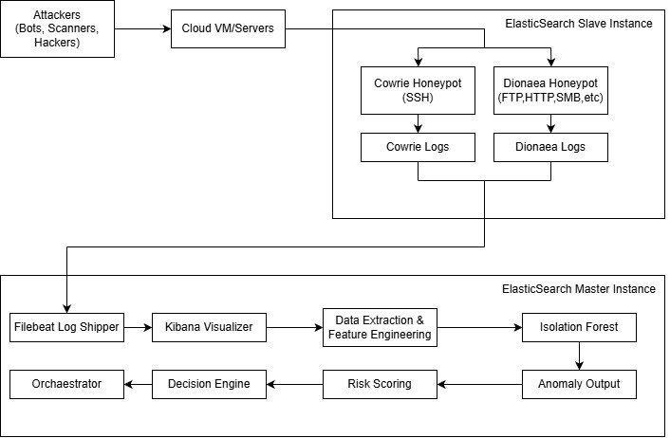
Methodology

Slide 17
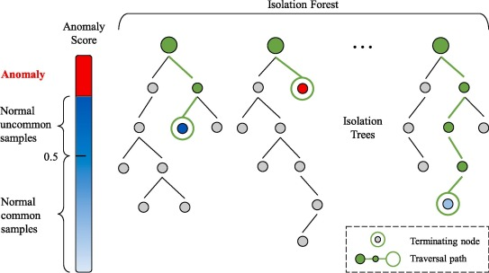
Methodology

Slide 18
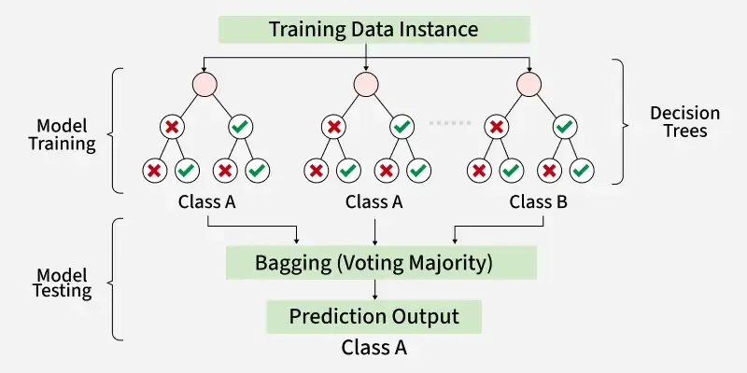
Methodology

Slide 19
Algorithm Details
Isolation Forest:
- Unsupervised learning (no labeled data needed)
- Detects anomalies efficiently
- Fast real-time scoring
- Works with small datasets
How It Works:
- Build ensemble of random decision trees
- Each tree isolates data points randomly
- Anomalies isolated faster (shorter path length)
- Calculate average path length for new session
- Shorter path → Higher anomaly score
- Score range: -1 (anomaly) to +1 (normal)

Slide 20
Algorithm Details
Random Forest:
- Supervised learning with labeled attack classes
- High accuracy for multi-class classification
- Robust to overfitting
- Provides feature importance rankings
- Handles non-linear relationships well
How It Works:
- An ensemble of 100 decision trees is created using bootstrap sampling of the data. - Each tree is trained on a random subset of features at every split. - The same input is passed to all trees for prediction. - Each tree independently votes for a class. - The final prediction is determined by majority voting, and probabilities are based on the proportion of votes.

Slide 21
Coding
import pandas as pd
from sklearn.ensemble import RandomForestClassifier
from sklearn.model_selection import train_test_split
from sklearn.metrics import accuracy_score, classification_report, confusion_matrix
from sklearn.preprocessing import StandardScaler, LabelEncoder
import joblib
import matplotlib.pyplot as plt
import seaborn as sns
df = pd.read_csv('sessions_features.csv')
def classify_session(row):
if row['has_download'] == 1 and row['has_priv_esc'] == 1:
return 'MALICIOUS'
elif row['has_recon'] == 1 or row['login_failures'] >= 2:
return 'RECON'
else:
return 'BENIGN'
df['label'] = df.apply(classify_session, axis=1)
feature_cols = ['duration_seconds', 'num_commands', 'unique_commands',
'has_download', 'has_priv_esc', 'has_recon',
'login_failures', 'login_success', 'file_uploads']
X = df[feature_cols].fillna(0)
y = df['label']
label_encoder = LabelEncoder()
y_encoded = label_encoder.fit_transform(y)

Slide 22
Coding
scaler = StandardScaler()
X_scaled = scaler.fit_transform(X)
X_train, X_test, y_train, y_test = train_test_split(
X_scaled, y_encoded, test_size=0.3, random_state=42, stratify=y_encoded
)
rf_model = RandomForestClassifier(n_estimators=100, max_depth=10, random_state=42, n_jobs=-1)
rf_model.fit(X_train, y_train)
y_pred = rf_model.predict(X_test)
accuracy = accuracy_score(y_test, y_pred)
df['predicted_label'] = label_encoder.inverse_transform(rf_model.predict(X_scaled))
df['prediction_confidence'] = rf_model.predict_proba(X_scaled).max(axis=1)
joblib.dump(rf_model, 'random_forest_model.pkl')
joblib.dump(scaler, 'rf_scaler.pkl')
joblib.dump(label_encoder, 'rf_label_encoder.pkl')
df.to_csv('rf_predictions.csv', index=False)
feature_importance = pd.DataFrame({
'feature': feature_cols,
'importance': rf_model.feature_importances_
}).sort_values('importance', ascending=False)
fig, axes = plt.subplots(2, 2, figsize=(14, 10))

Slide 23
Coding
axes[0, 0].barh(feature_importance['feature'], feature_importance['importance'])
axes[0, 0].set_xlabel('Importance')
axes[0, 0].set_title('Feature Importance')
axes[0, 0].invert_yaxis()
cm = confusion_matrix(y_test, y_pred)
sns.heatmap(cm, annot=True, fmt='d', cmap='Blues',
xticklabels=label_encoder.classes_, yticklabels=label_encoder.classes_, ax=axes[0, 1])
axes[0, 1].set_title('Confusion Matrix')
class_counts = df['label'].value_counts()
axes[1, 0].bar(class_counts.index, class_counts.values, color=['green', 'orange', 'red'])
axes[1, 0].set_title('Class Distribution')
axes[1, 0].tick_params(axis='x', rotation=45)
axes[1, 1].hist(df['prediction_confidence'], bins=10, edgecolor='black')
axes[1, 1].set_title('Prediction Confidence')
axes[1, 1].axvline(x=0.8, color='r', linestyle='--', label='80% threshold')
axes[1, 1].legend()
plt.tight_layout()
plt.savefig('rf_analysis.png', dpi=150, bbox_inches='tight')
print(f"✅ Random Forest trained: {accuracy*100:.1f}% accuracy")
print(f"✅ Class distribution: {dict(df['label'].value_counts())}")
print(f"✅ Saved: random_forest_model.pkl, rf_scaler.pkl, rf_label_encoder.pkl, rf_predictions.csv, rf_analysis.png")

Slide 24
Results & Conclusion
Dataset Statistics:
- Total Events Captured: 43,303
- Time Period: March 2026 (24days)
- Unique Sessions: 236 Cowrie sessions analyzed
Attack Distribution:
- Dionaea (malware): 99.2% (30,000+ events)
- Cowrie (SSH): 0.8% (500+ events)
Geographic Sources:
- Top attacker IPs: 223.178.85.50, 185.201.147.210, 130.12.180.51
- Attack vectors: SSH brute-force, malware uploads, reconnaissance

Slide 25
Results & Conclusion
ML Model Performance:
Training Results:
- Sessions analyzed: 236
- Anomalies detected: 2 (22%)
- Normal sessions: 7 (78%)
Detected Patterns:
- Download attempts (wget, curl)
- Privilege escalation (sudo, chmod)
- Reconnaissance (whoami, uname, ps)

Slide 26
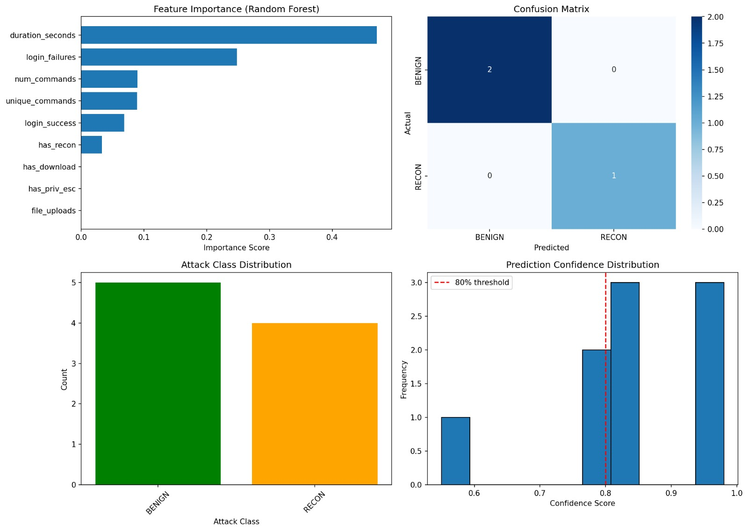
Results & Conclusion

Slide 27
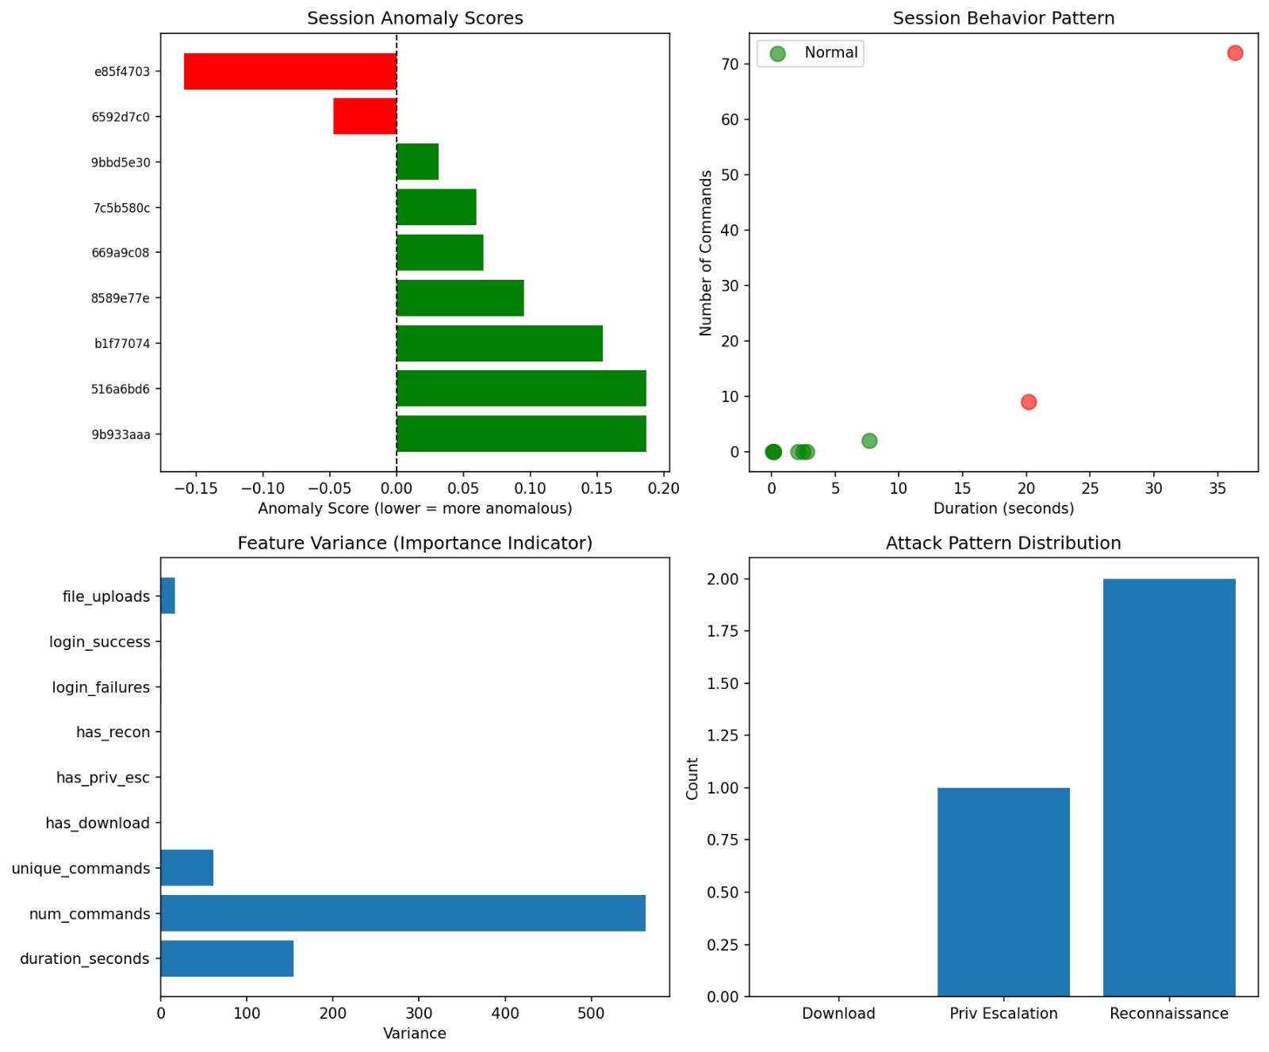
Results & Conclusion

Slide 28
Discussion
Key Findings
- Real-time anomaly detection is feasible
- ML model successfully distinguished anomalous sessions
- Average scoring time <500ms
- Behavioral features are effective
- Download attempts, privilege escalation, and reconnaissance commands strongly correlate with malicious
intent
- Adaptive approach is viable
- System demonstrated capability to make contextual decisions based on attacker behavior

Slide 29
Limitations & Mitigations
Limitations:
- Lab environment only (not production-facing)
- Limited dataset size (236 sessions)
- Adaptive actions logged but not executed
- Single honeypot instance (not distributed)
Mitigation:
- Proof-of-concept demonstrates viability
- Longer deployment would yield more data
- Execution layer is future work
- Architecture supports multi-honeypot scaling

Slide 30
References
[1] N. Ilg, P. Duplys, D. Sisejkovic, and M. Menth, "A survey of contemporary open-source honeypots, frameworks, and tools," Journal of Network and Computer Applications, vol. 220, p. 103737, Nov. 2023.
[2] L. Huang and Q. Zhu, "Adaptive honeypot engagement through reinforcement learning of semi-Markov decision processes," in Proc. GameSec 2019, LNCS vol. 11836, pp. 196–216, 2019.
[3] S. Dowling, M. Schukat, and E. Barrett, "Using reinforcement learning to conceal honeypot functionality," in Proc. ECML PKDD 2018, LNCS vol. 11053, pp. 341–355, Springer, 2019.
[4] A. Satpute, S. Nikam, V. Gaikwad, Y. Kakade, and C. Mhaske, "AI-driven intrusion detection system using SSH honeypots," ICCK Transactions on Cybersecurity, vol. 1, no. 1, pp. 3–12, 2025. DOI: 10.62762/TC.2025.521799
[5] A. A. Prasetyo, Herianto, Yahya, and N. Syamsiyah, "Detection of SSH brute force attacks using Naïve Bayes classification on Cowrie honeypot logs in a virtualized environment," Journal TIFDA, vol. 2, no. 1, pp. 62–65, 2025. DOI: 10.70491/tifda.v2i1.88
[6] M. Tzovaras et al., "Optimizing Internet of Things honeypots with machine learning: A review," Applied Sciences, vol. 15, no. 10, p. 5251, May 2025. DOI: 10.3390/app15105251

Slide 31
Thank You

